Slide 1
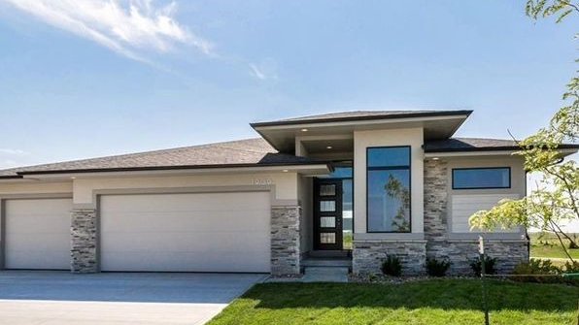
AMES IOWA HOUSING MARKET
CAPSTONE 2 - PRESENTATION
Notes:
Hello and thank you for coming to my Capstone 2 presentation on the Ames Iowa Housing Market!

Slide 2
AMES IOWA – HOUSING MARKET
Introduction to Ames Iowa
Neighborhood Map of Ames
Data Insights
Statistical T-test: Bedrooms
Statistical T-test: Bathrooms
Statistical T-test: Garages
Statistical T-test: Central Air
Recommendations: Optimal Homes for Investments
Recommendations: Homes to Purchase by Neighborhood.

Slide 3
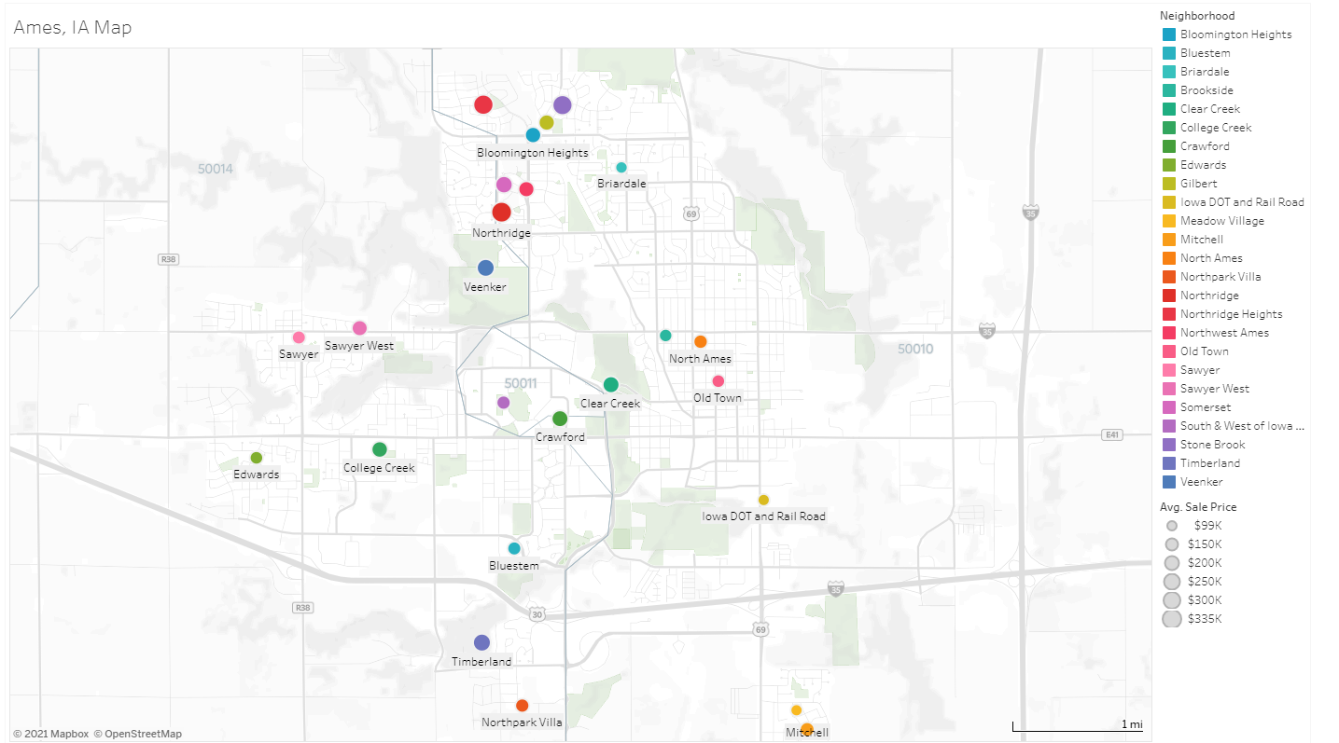
AMES IOWA: A PLACE TO CALL HOME
Ames, located in central Iowa, has a population of 66,023. Ames is in Story County and is one of the best places to live in Iowa. Living in Ames offers residents an urban suburban mix and most residents rent their homes. In Ames there are a lot of bars, coffee shops, and parks. Many young professionals live in Ames and residents tend to lean conservative. The public schools in Ames are highly rated.
Info: Niche.com
Notes:
Ames Iowa
Home of the Iowa State University Cyclones
Most residents RENT
Great Night Life
A+ Schools

Slide 4
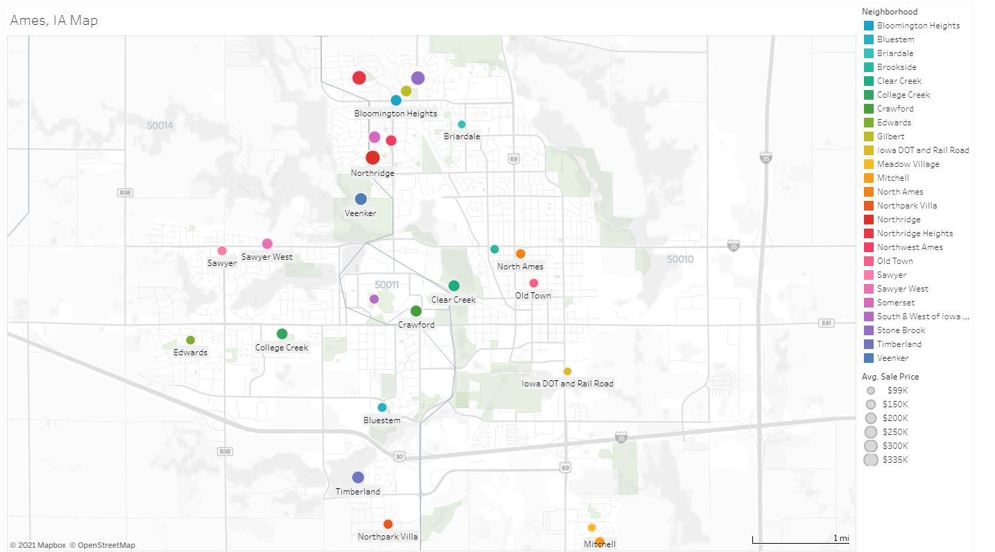
NEIGHBORHOOD MAP OF AMES
Tableau | Ames, IA Neighborhood Map

Slide 5
DATA INSIGHTS: SALE PRICES BY NEIGHBORHOOD
Notes:
Highest: Northridge - $755K
Lowest: Iowa DOT and Rail Road $349K

Slide 6
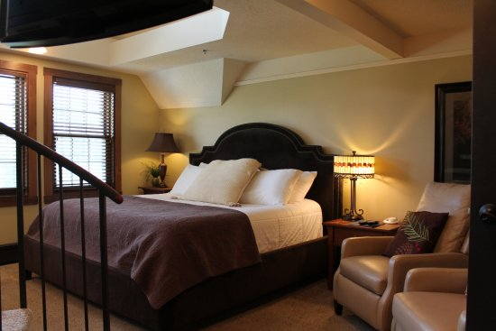
STATISTICAL T-TEST: BEDROOMS
3 Bedrooms or Less - $174,213.11 - Sample Size 1218
4 or more bedrooms - $214,683.39 - Sample Size 242
Notes:
Homes that have 4 or more bedrooms sell on average about 40K more that homes that have 3 or less bedrooms.
3 or Less - $174,213.11 - Sample Size 1218
4 or more - $214,683.39 - Sample Size 242
Our p-value is less than .05, therefore we reject the null hypothesis concluding there is a statistically significant difference between the mean and our hypothesized Sales Price of homes with 4 or more bedrooms above ground

Slide 7
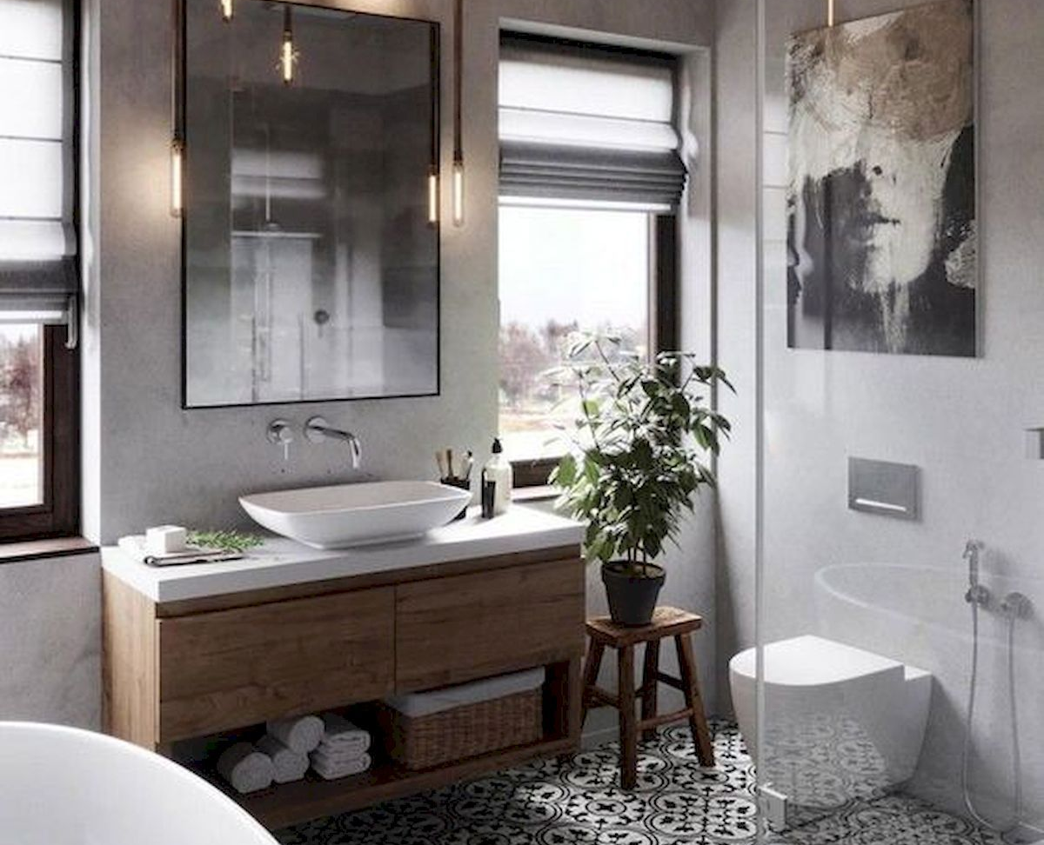
STATISTICAL T-TEST: FULL BATHROOMS
1 or 2 Bath - $160,599.25 - Sample Size 935
3 or 4 bath - $268,839.37 - Sample Size 283
Notes:
Single family homes that have 3 or more full bathrooms sell on average about 108K more than single family homes that have 3 or less full bathrooms.
1 or 2 Bath - $160,599.25 - Sample Size 935
3 or 4 bath - $268,839.37 - Sample Size 283
Our p-value is less than .05, therefore we reject the null hypothesis concluding there is a statistically significant difference between the mean and our hypothesized Sales Price of Single-family homes with 3 or more Bathrooms.

Slide 8
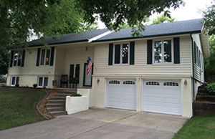
STATISTICAL T-TEST: GARAGES
0 to 1 Cars - $ 123,652.80 - Sample Size 450
2 or more - $ 206,436.82 - Sample Size 1010
Notes:
Homes with 2 or more car garages on average are sold up to 83K more than other homes.
0 to 1 Cars - $123,652.80 - Sample Size 450
2 or more - $206,436.82 - Sample Size 1010
Our p-value is less than .05, therefore we reject the null hypothesis concluding there is a statistically significant difference between the mean and our hypothesized Sales Price of homes with 2 or more car garages

Slide 9
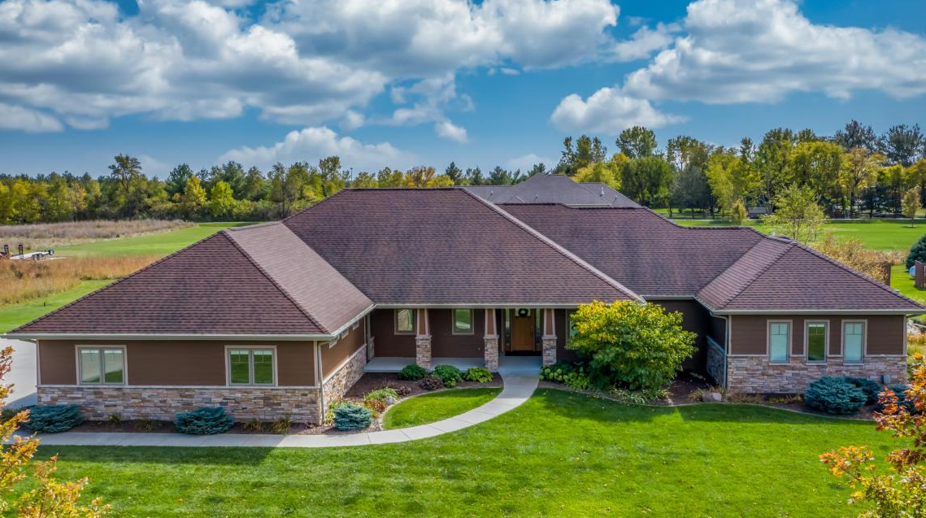
STATISTICAL T-TEST: CENTRAL AIR
Other - $105,264.07 - Sample Size 95
Central Air - $186,186.71 – Sample Size 1365
Notes:
Homes with Central Air on average are sold up to 81K more than other homes.
Other - $105,264.07 - Sample Size 95
Central Air - $186,186.71 – Sample Size 1365
Our p-value is less than .05, therefore we reject the null hypothesis concluding there is a statistically significant difference between the mean and our hypothesized Sales Price of homes with Central Air

Slide 10
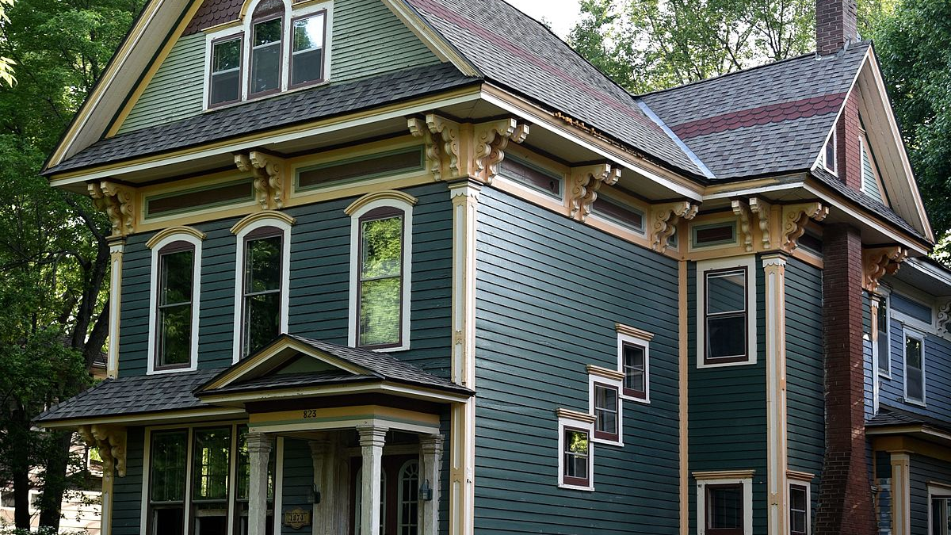
RECOMENDATIONS: IDEAL HOMES FOR INVESTMENTS
Single Family Homes that have:
4 or more bedrooms
3 or more full bathrooms
Central Air Conditioning
2 or more Car Garages
Listed at <$150K to allow for improvements.
Notes:
For my recommendations I

Slide 11
RECOMMENDATIONS: HOMES BY NEIGHBORHOOD
Notes:
I have identified 23 homes that meet all the criteria based on my statical testing.
Total cost to purchase these homes would be just over $3ML
Because these homes are currently on the market for 150K or less the potential to increase the equity in these homes after renovations is significant.

Slide 12
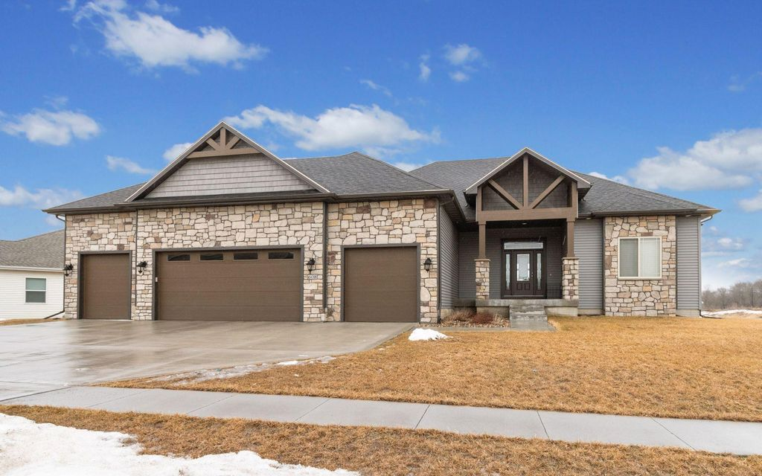
QUESTIONS

